Slide 1

Database Systems
CS 372
LAB 6

Slide 2


Agenda
Basic Retrieval Queries in SQL: SELECT Query:
1
DISTINCT
2
ALIAS
3
UNION
4
INTERSEC
5
EXCEPT

Slide 3

1. DISTINCT

Slide 4
DISTINCT
The SQL DISTINCT clause is used together with the SQL SELECT keyword, to return a dataset with unique entries for certain database table column.
Syntax:
The default display of queries is all rows, including duplicate rows.
By using DISTINCT in the SELECT clause, duplicate Rows are Eliminated.
SELECT DISTINCT Column_name FROM Table_name
select Dno from employee
select distinct Dno
from employee

Slide 5
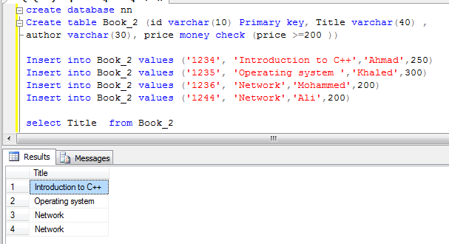
DISTINCT (Cont.)
Retrieve the different (Without duplicate )Title from Book?

Slide 6
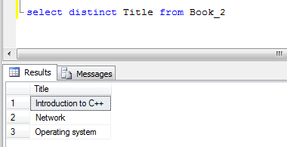
DISTINCT (Cont.)
SELECT DISTINCT Title FROM Book_2

Slide 7
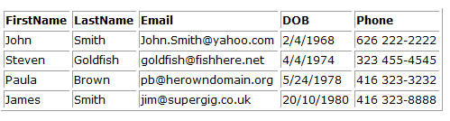
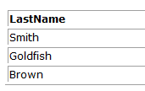
DISTINCT (Cont.)
Retrieve the different Last Name from Customer?
SELECT DISTINCT LastName FROM Customers

Slide 8

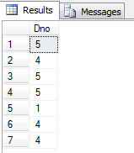
DISTINCT (Cont.)
Retrieve the different Dno FROM employee?

Slide 9
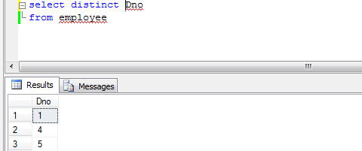
DISTINCT (Cont.)
SELECT DISTINCT Dno FROM employee

Slide 10
2. Alias

Slide 11
Alias
You can give a table or a column another name by using an Alias. So, You can rename a table or a column by giving another name known as alias.
The use of table aliases means to rename a table in a particular SQL statement. The renaming is a temporary change and the actual table name does not change in the database.
This can be a good thing to do if you have very long or complex table names or column names.

Slide 12
Alias
Tip: It require double quotation marks or square brackets if the column name contains spaces , special characters or Keyword.
Syntax:
SELECT column_name AS alias_name FROM table_name

Slide 13
Alias (Cont.)
Retrieve id and title from Book_2 after renaming the column names of id and title to Book_identifer and book title respectively ?
SELECT id AS Book_identifer, Title AS "book title"
FROM Book_2

Slide 14
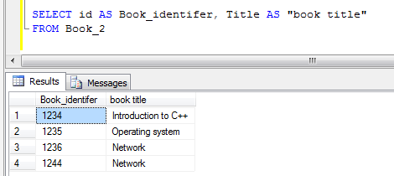
Alias (Cont.)
Retrieve id and title from Book_2 after renaming the column names of id and title to Book_identifer and book title respectively ?

Slide 15
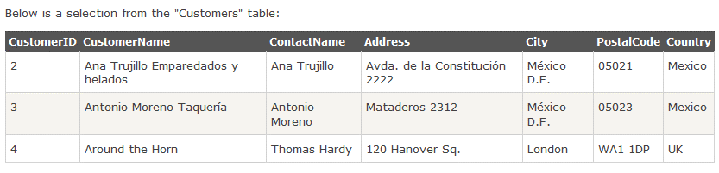
Alias (Cont.)
Retrieve CustomerName and ContactName from Customers after renaming these columns to Customer and Contact Person respectively ?

Slide 16
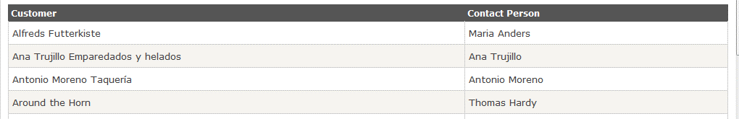
Alias (Cont.)
SELECT CustomerName AS Customer,
ContactName AS “Contact Person” FROM Customers

Slide 17
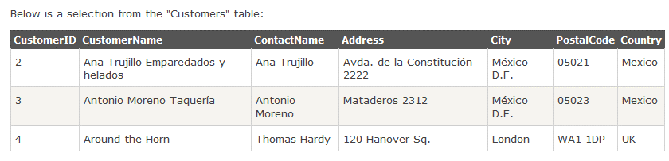
Alias (Cont.)
Retrieve two attributes (CustomerName and Address ), Address contains the following columns: (Address, City, PostalCode, and Country) from Customers?
Solution: In the second attribute, you have to combine four columns (Address, City, PostalCode, and Country) , notice that the content of these column are varchar data type. Then, create an alias named "Address“.

Slide 18
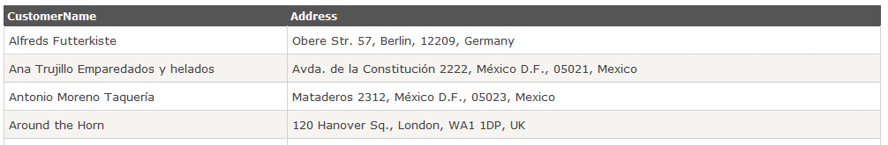
Alias (Cont.)
SELECT CustomerName, Address+', '+City+', '+PostalCode+', '+Country AS Address FROM Customers

Slide 19
Combine the Text content of more than one columns In select Command:
In select Command, To combine more than one columns in one column(if their data type are character Type[Char, varchar..etc] ), use concatenation between columns:
Column_name1 + ‘, ‘ + Column_name2 + ‘, ‘ + Column_namen3 + ‘, ‘ +Column_name 4
As RequiredColumName

Slide 20
Combine the Text content of more than one columns In select Command:
This method apply on character data type while in Numeric data type there is No need to combine the content which contains number.
Usually, we define Numeric data type to apply arithmetic operations not for combine them in one column.

Slide 21
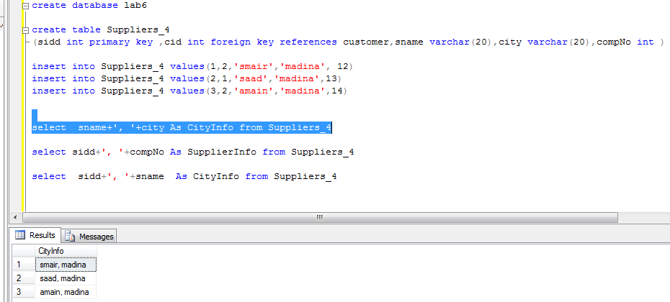
Combine the Text content of more than one columns In select Command: (cont.)

Slide 22
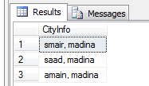
Combine the Text content of more than one columns In select Command: (cont.)
Execution of:
select sname+', '+city As CityInfo
from Suppliers_4

Slide 23
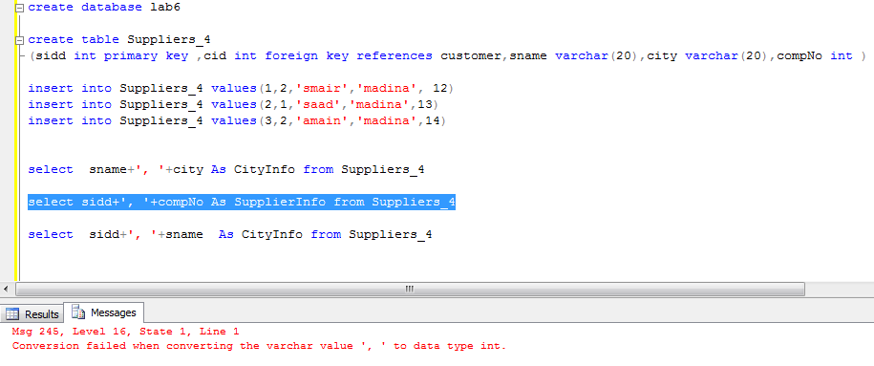
Combine the Text content of more than one columns In select Command: (cont…)

Slide 24

Combine the Text content of more than one columns In select Command: (cont…)
Execution of:
select sidd+', '+compNo As SupplierInfo
from Suppliers_4

Slide 25
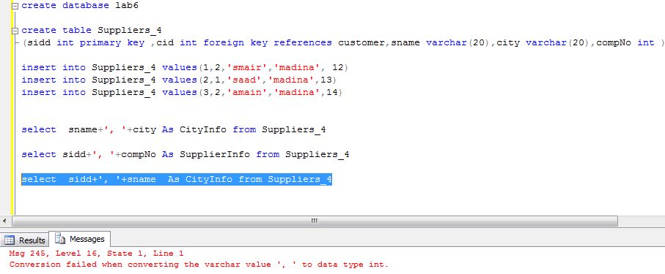
Combine the Text content of more than one columns In select Command: (cont…)

Slide 26

Combine the Text content of more than one columns In select Command: (cont…)
Execution of:
select sidd+', '+sname As CityInfo
from Suppliers_4

Slide 27
Columns have the same names in different tables:
If there are columns have the same names in different tables, if we used them in one query, you have to specify which column follow which table.
If the table has long name, we can use Alias first then specify the columns with the new name.
In Select Command:
Table_name.Column name
Table_name As New_ Table_name
New_Table_name.Column name
Select New_Table_name.Column name
From Table_name As New_ Table_name

Slide 28
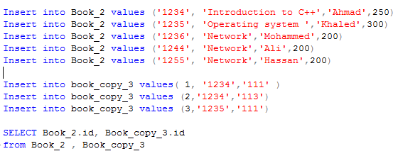
Alias (Cont.)
Retrieve id from Book_2 and Book_copy_3 in one SQL query?

Slide 29
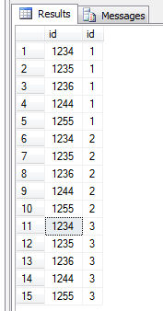
Alias (Cont.)
Retrieve id from Book_2 and Book_copy_3 in one SQL query?
Output:

Slide 30
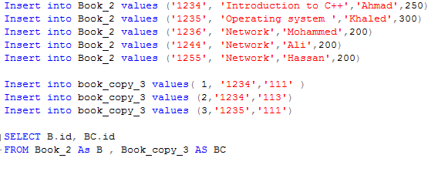
Alias (Cont.)

Slide 31
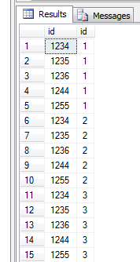
Alias (Cont.)
Output:
Notice that
Alias name is temporary name and it doesn't change the names of table and column in the data base.
In this Example, Alias name for “ Book_2” Table is B. So, if we try to retrieve the record in B table in another statement , we get error.

Slide 32
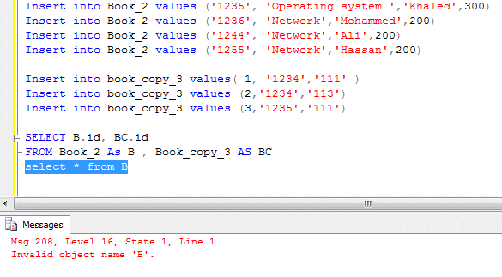
Alias (Cont.)

Slide 33
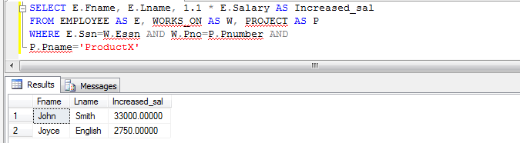
Alias (Cont.)
Alias is useful with calculations.
SELECT E.Fname, E.Lname, 1.1 * E.Salary AS Increased_sal
FROM EMPLOYEE AS E, WORKS_ON AS W, PROJECT AS P
WHERE E.Ssn=W.Essn AND W.Pno=P.Pnumber AND P.Pname='ProductX'

Slide 34
Alias (Cont.)
EMPLOYEE
WORKS_ON
PROJECT
Ssn
Pno
Pnumber
Essn
Alias is useful with calculations.
SELECT E.Fname, E.Lname, 1.1 * E.Salary AS Increased_sal
FROM
EMPLOYEE AS E, WORKS_ON AS W, PROJECT AS P
WHERE
E.Ssn=W.Essn
AND W.Pno=P.Pnumber
AND P.Pname='ProductX'

Slide 35
Alias (Cont.)

Slide 36
Alias (Cont.)
Aliases can be useful when:
Functions are used in the query(Later).
Arithmetic operator(To rename the new column).
Column names are big or not very readable.
The names may be not clear for the reader(Unreadable). For that, we can used Alias to rename that columns.
Two or more columns are combined together.

Slide 37
3. UNION

Slide 38

UNION
The purpose of the SQL UNION and UNION ALL commands are to combine the results of two or more queries into a single result set consisting of all the rows belonging to all the queries in the union.
UNION acts as an OR operator (value is selected if it appears in either the first or the second query.
Note: The UNION operator selects only distinct values by default. To allow duplicate values, use the UNION ALL keyword with UNION.
The main difference between UNION ALL and UNION is the following:
UNION ALL | UNION
UNION ALL selects all values (including duplicates). | UNION only selects distinct values .

Slide 39
UNION
Syntax:
SELECT column_name(s) FROM table_name_1 UNION / UNION ALL SELECT column_name(s) FROM table_name_2

Slide 40
UNION (Cont.)
The basic rules for combining the result sets of two queries that use Union :
The number and the order of the columns must be the same in all queries.
2. The data types must be compatible (Or the same).

Slide 41
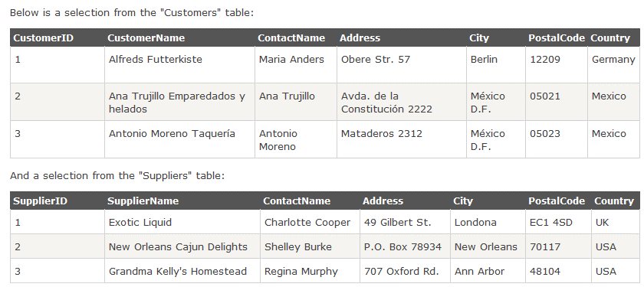
UNION (Cont.)
Retrieve all the different cities from the "Customers" and the "Suppliers“?
City
Ann Arbor
Berlin
London
Meexico D.F.
New Orleans
SELECT City FROM Customers UNION SELECT City FROM Suppliers ORDER BY City
Output:

Slide 42
UNION (Cont.)
Retrieve all the All cities from the "Customers" and the "Suppliers“?
SELECT City FROM Customers UNION ALL SELECT City FROM Suppliers ORDER BY City
Output:
City
Ann Arbor
Berlin
London
Meexico D.F.
Meexico D.F.
New Orleans

Slide 43
UNION (Cont.)
Retrieve all German cities from the "Customers" and "Suppliers" ?
SELECT City, Country FROM Customers WHERE Country='Germany' UNION ALL SELECT City, Country FROM Suppliers WHERE Country='Germany'
Output:
City | Country
Berlin | Germany

Slide 44
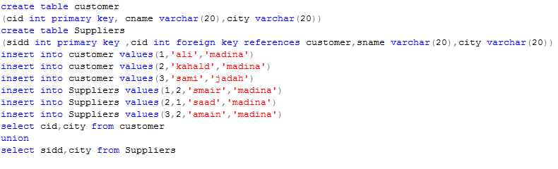
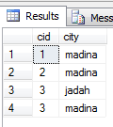
UNION operation for more than one column
Union

Slide 45
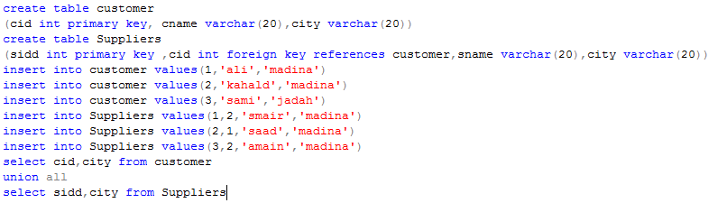
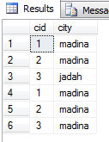
UNION operation for more than one column
Union ALL

Slide 46
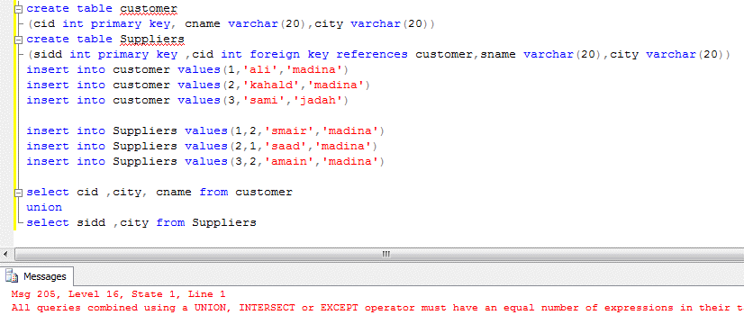
UNION ( Discussion of first condition: The number of the columns must be the same in all queries)
3 columns
2 columns

Slide 47
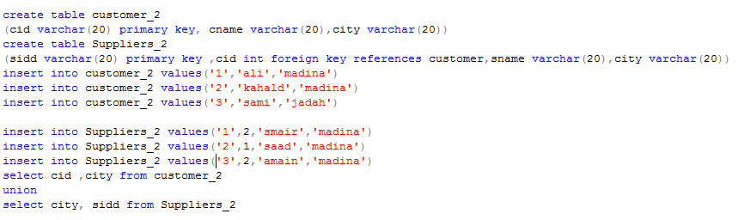
UNION ( Discussion of first condition: The order of the columns must be the same in all queries)
If you change the order of columns in Select Statement(such as if order of columns in the first Select statement differs from the second Select statement), it consider as different data.

Slide 48
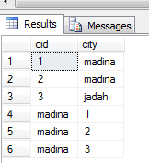
UNION ( Discussion of first condition: The order of the columns must be the same in all queries)
EX: (1, madinah) differs from (madinah,1)

Slide 49
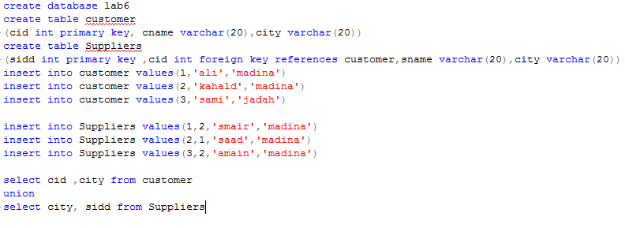
UNION ( Discussion of second condition: The data types must be compatible )
EX: the first columns in each Select student has different data type.
Cid→ int
City → varchar(20)

Slide 50

UNION ( Discussion of second condition: The data types must be compatible )

Slide 51
4. INTERSECT

Slide 52
INTERSECT
The SQL INTERSECT query allows you to return the results of 2 or more "select" queries.
INTERSECT acts as an AND operator (value is selected only if it appears in both)
The basic rules for combining the result sets of two queries that use INTERSECT :
1. The number and the order of the columns must be the same in all queries. 2. The data types must be compatible (Or the same).

Slide 53
INTERSECT
Syntax:
SELECT Clomns_name FROM Table_name
INTERSECT
SELECT Clomns_name FROM Table_name

Slide 54

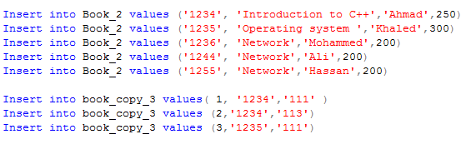
INTERSECT (Cont.)

Slide 55
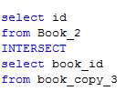

INTERSECT (Cont.)
In this SQL INTERSECT query example, if an id appeared in both the Book_2 and Book_2 table, it would appear in your result set.

Slide 56
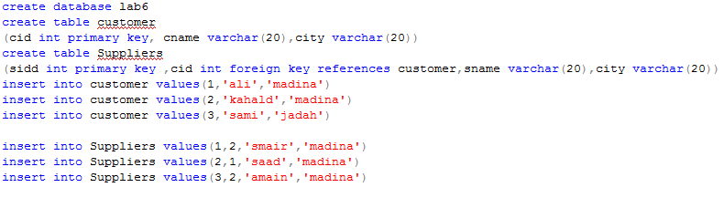
INTERSECT : Another representation of Intersect (Using AND IN )

Slide 57
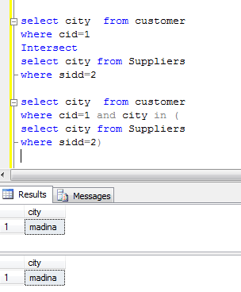
INTERSECT : Another representation of Intersect (Using AND IN )
select city from customer
where cid=1
Intersect
select city from Suppliers
where sidd=2
select city from customer
where cid=1 AND city IN (
select city from Suppliers
where sidd=2)
This is query contains another query.

Slide 58
Difference between Union & Intersect :
Intersect | Union
INTERSECT command combines two or more SELECT statements and it acts as an AND operator (value is selected only if it appears in both) . | UNION combines two or more SELECT statements and it acts as an OR operator (value is selected if it appears in either the first or the second statement).
The basic rules for combining the result sets of two queries that use Union or INTERSECT are the following: 1. The number and the order of the columns must be the same in all queries. 2. The data types must be compatible (Or the same).

Slide 59
5. EXCEPT

Slide 60
EXCEPT (MINUS )
EXCEPT clause in SQL Server is exactly similar to MINUS operation in Oracle.
The EXCEPT operator is used to combine two SELECT statements and it evaluates the output of two query expressions and returns the difference between the results. The result set contains all rows returned from the first query expression except those rows that are returned from the second query expression.
This means EXCEPT returns only rows, which are not available in second SELECT statement.
Notice that If the second SQL statement includes results not present in the first SQL statement, such results are ignored.
Syntax:
SELECT Clomns_name FROM Table_name
EXCEPT
SELECT Clomns_name FROM Table_name

Slide 61
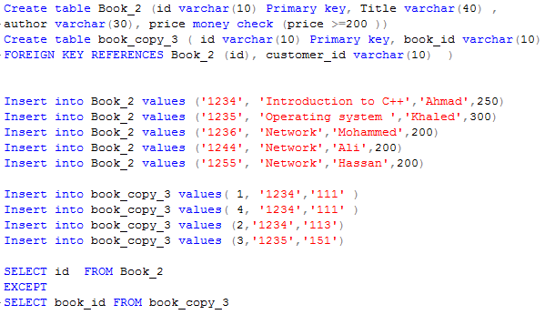
EXCEPT : Example

Slide 62
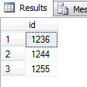
EXCEPT : Example
SELECT id FROM Book_2
EXCEPT
SELECT book_id FROM book_copy_3

Slide 63
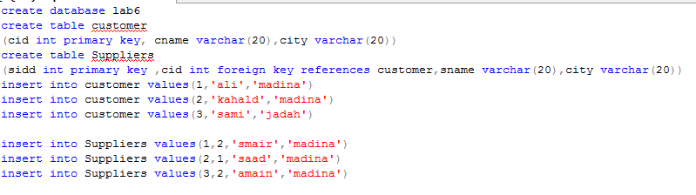
Except : Another representation of Intersect (Using AND Not IN )

Slide 64
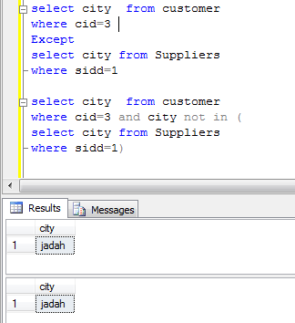
Except : Another representation of Intersect (Using AND Not IN )

Slide 65
Difference between Intersect & EXCEPT:
EXCEPT | Intersect
EXCEPT combines two SELECT statements and returns rows from the first SELECT statement that are not returned by the second SELECT statement. | INTERSECT combines two SELECT statements but returns rows only from the first SELECT statement that are identical to a row in the second SELECT statement.
The basic rules for combining the result sets of two queries that use EXCEPT or INTERSECT are the following: 1. The number and the order of the columns must be the same in all queries. 2. The data types must be compatible (Or the same).

Slide 66
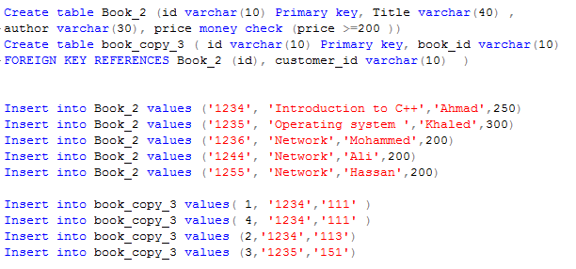
EXCEPT( Discussion of first condition: The number and the order of the columns must be the same in all queries)
All queries combined using a UNION, INTERSECT or EXCEPT operator must have an equal number of expressions in their target lists. (Must be the same number of columns)

Slide 67
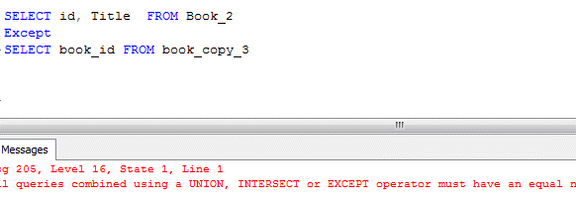
EXCEPT( Discussion of first condition: The number and the order of the columns must be the same in all queries)

Slide 68
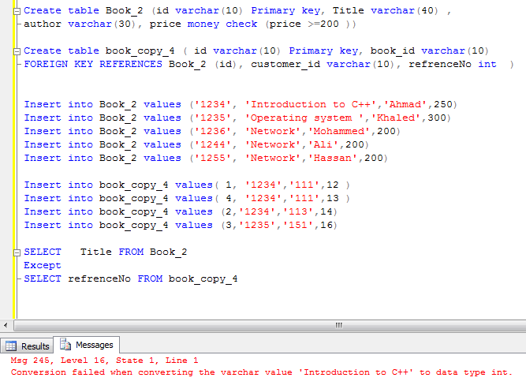
EXCEPT( Discussion of Section condition: The data types must be compatible)
Ex of incommutability of data types: varchar(n) and int.

Slide 69

Exercise
Create a data base (company)
Create two tables in the database:
Employee
employee_no | e_name | Salary | phone | d_no
1456 | Ahmad | 4000 | 0555558888 | 1
1457 | Khaled | 4500 | 0555553333 | 2
1458 | Ahmad | 3000 | 0555554444 | 3
1459 | Mohamed | 6000 | 0555555777 | 4
Department
d_no | d_name | manager_no
1 | CS | 1457
2 | IS | 1459
3 | SE | 1444
4 | CS | 1433
5 | CS | 1411
Note: d_no in Department is primary key.
3. Retrieve the different e_name from Employee using descending order on Salary.

Slide 70
4.Drop Salary attribute from Employee.
5. Retrieve all d_no from the " Employee " and the "Department“?
6. Retrieve d_no that can be found in " Employee " and "Department“?
7. Retrieve all d_no from the " Department " ? In different SQL query Retrieve all d_no from the " Employee “? Then use Except between these queries?
8. Rename Employee and Department with the following names: ‘E’ and ‘D’ respectively. Then, retrieve the d_no from the two tables in one SQL statement.

